Slide 1

Chapter Four
Fluid Mechanics
Kinde Yeneayehu
June, 2022
ASTU
(ASTU)
Cover Page - 1/34
June, 2022

Slide 2
Properties of Bulk Matter /Stress, Strain
Although a solid may be thought of as having a definite shape and volume, it‘s possible to change its shape and volume by applying external forces.
A sufficiently large force will permanently deform or break an object, but otherwise, when the external forces are removed, the object tends to return to its original shape and size. This is called elastic behavior.
(ASTU)
Properties of Bulk Matter /Stress, Strain- 2/34
June, 2022

Slide 3
Properties of Bulk Matter /Stress, Strain
Elastic materials are materials that regain their original shape and size when the deforming force is removed.
Elastic deformation is a reversible deformation by a force applied within the elastic limit. Beyond elastic limit, a force applied on an object causes permanent and irreversible deformation called plastic deformation.
Plastics materials: do not regain their original shape and size when the deforming force is removed.
The elastic properties of solid materials are described in terms of stress and strain.
(ASTU)
Properties of Bulk Matter /Stress, Strain- 3/34
June, 2022

Slide 4
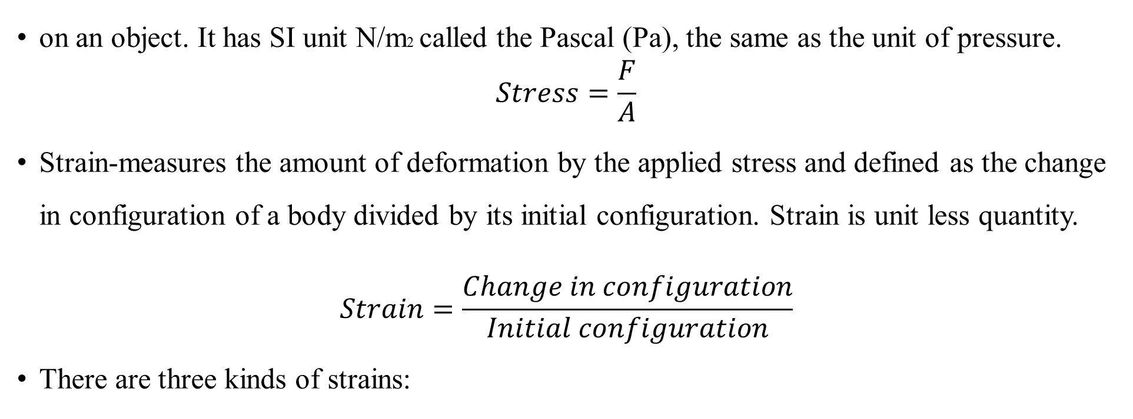
Properties of Bulk Matter /Stress, Strain
Stress is the force per unit area that is causing some deformation
on an object. It has SI unit N/m2 called the Pascal (Pa), the same as the unit of pressure.
$$Stress=\frac{F}{A}$$
Strain-measures the amount of deformation by the applied stress and defined as the change in configuration of a body divided by its initial configuration. Strain is unit less quantity.
$$Strain=\frac{Change in configuration}{Initial configuration}$$
There are three kinds of strains:
(ASTU)
Properties of Bulk Matter /Stress, Strain- 4/34
June, 2022

Slide 5
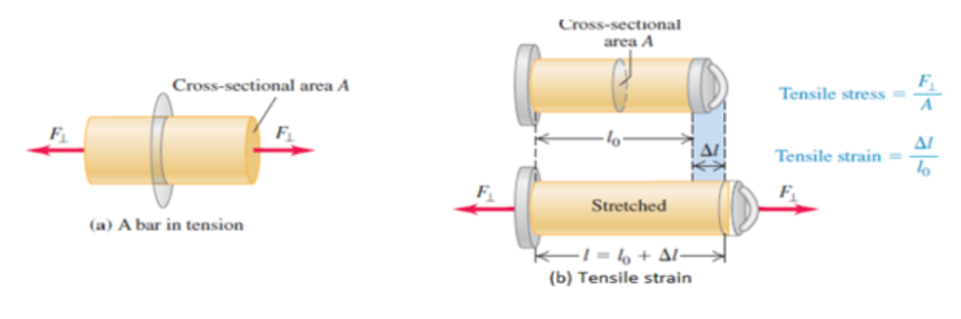
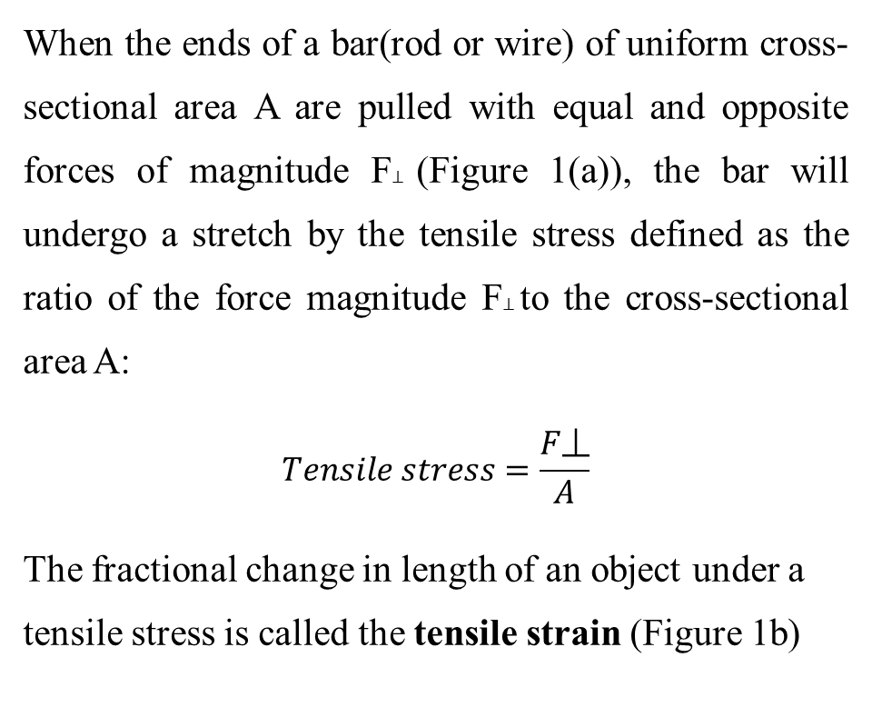
Properties of Bulk Matter /Stress, Strain
1. Tensile Strain
When the ends of a bar(rod or wire) of uniform cross-sectional area A are pulled with equal and opposite forces of magnitude F⊥ (Figure 1(a)), the bar will undergo a stretch by the tensile stress defined as the ratio of the force magnitude F⊥ to the cross-sectional area A:
$$Tensile stress=\frac{F\text{⏊}}{A}$$
The fractional change in length of an object under a tensile stress is called the tensile strain (Figure 1b)
Figure. 1.
(ASTU)
Properties of Bulk Matter /Stress, Strain- 5/34
June, 2022

Slide 6
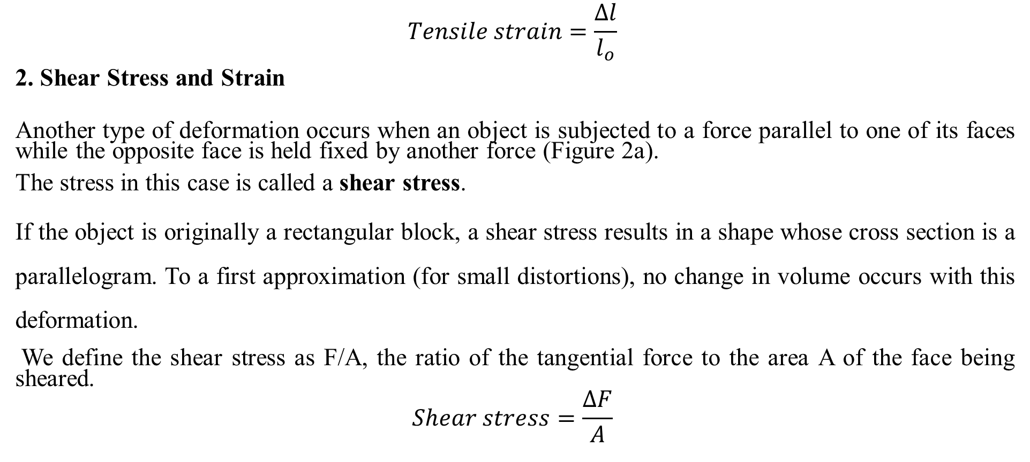
Properties of Bulk Matter /Stress, Strain
$$Tensile strain=\frac{Δl}{l_{o}}$$
2. Shear Stress and Strain
Another type of deformation occurs when an object is subjected to a force parallel to one of its faces while the opposite face is held fixed by another force (Figure 2a).
The stress in this case is called a shear stress.
If the object is originally a rectangular block, a shear stress results in a shape whose cross section is a parallelogram. To a first approximation (for small distortions), no change in volume occurs with this deformation.
We define the shear stress as F/A, the ratio of the tangential force to the area A of the face being sheared.
$$Shear stress=\frac{ΔF}{A}$$
(ASTU)
Properties of Bulk Matter /Stress, Strain- 6/34
June, 2022

Slide 7
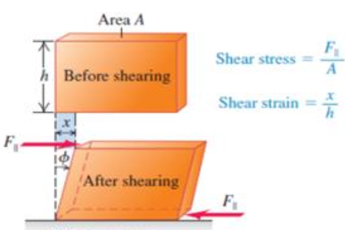
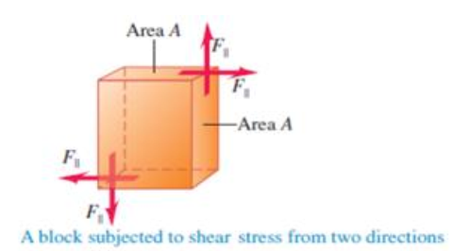
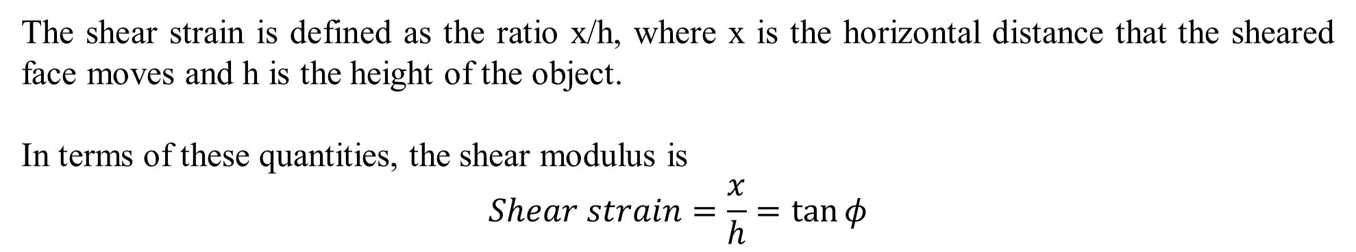
Properties of Bulk Matter /Stress, Strain
The shear strain is defined as the ratio x/h, where x is the horizontal distance that the sheared face moves and h is the height of the object.
In terms of these quantities, the shear modulus is
$$Shear strain=\frac{x}{h}=\tan{φ}$$
a) shear stress
b) shear strain
Figure 2: Shows an object deformed by a shear stress, a) shear stress and b) shear strain
(ASTU)
Properties of Bulk Matter /Stress, Strain- 7/34
June, 2022

Slide 8
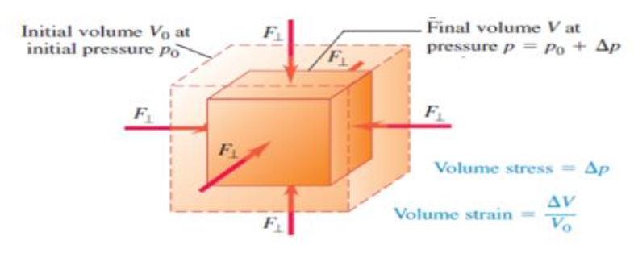
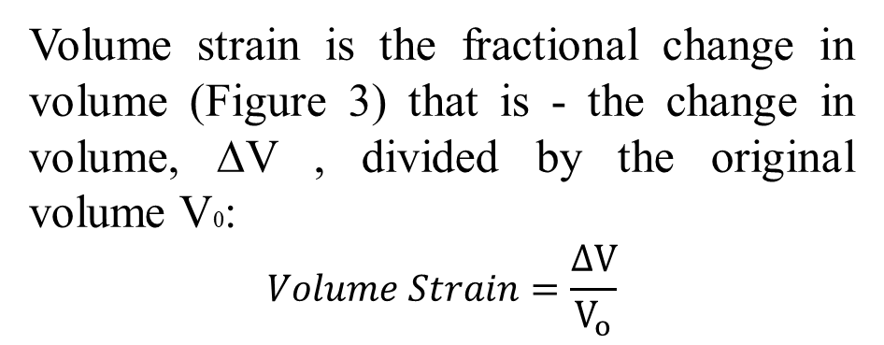
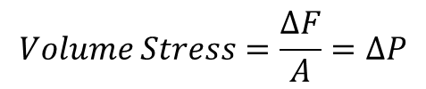
Properties of Bulk Matter /Stress, Strain
3. Volume Stress and Strain
Volume Stress is a stress which causes volume deformation on an object and defined as the ratio of the change in the magnitude of the applied force ∆F to the surface area A.
$$Volume Stress=\frac{ΔF}{A}=ΔP$$
Volume strain is the fractional change in volume (Figure 3) that is - the change in volume, ∆V , divided by the original volume V0:
$$Volume Strain=\frac{ΔV}{V_{o}}$$
Figure .3: A block undergoing volume strain by the applied volume stress
(ASTU)
Properties of Bulk Matter /Stress, Strain- 8/34
June, 2022

Slide 9
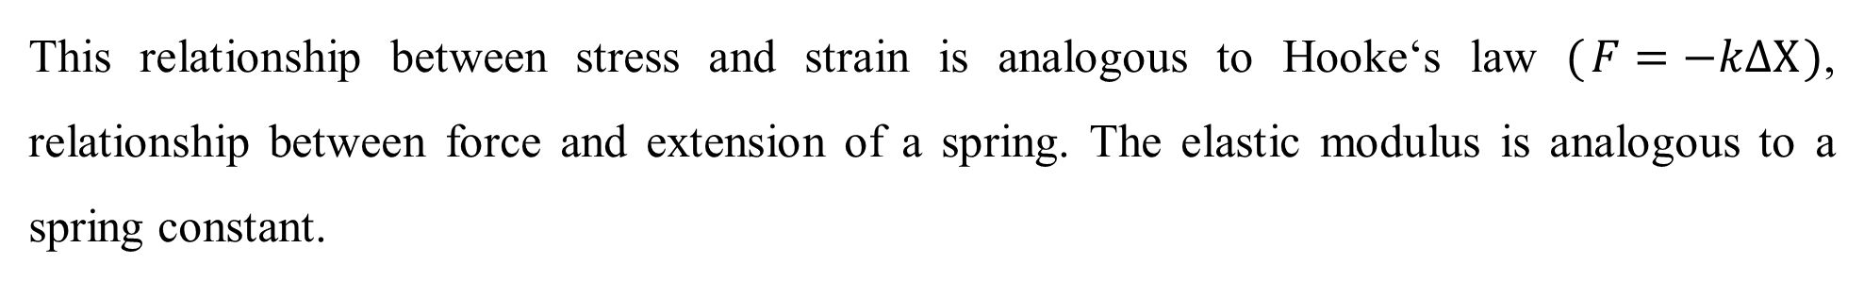
Properties of Bulk Matter /Stress, Strain
Elasticity Moduli
The stress will be proportional to the strain if the stress is sufficiently small. In this regard, the proportionality constant known as elastic modulus depends on the material being deformed and on the nature of the deformation.
This relationship between stress and strain is analogous to Hooke‘s law ($F=−kΔX$), relationship between force and extension of a spring. The elastic modulus is analogous to a spring constant.
(ASTU)
Properties of Bulk Matter /Stress, Strain- 9/34
June, 2022

Slide 10

Properties of Bulk Matter /Stress, Strain
Corresponding to the three types of strains, there are three types of elastic module.
1. Young‘s Modulus: is the ratio of the tensile stress to the tensile strain. It measures the resistance of a solid to a change in its length and typically used to characterize a rod or wire stressed under either tension or compression.
2. Shear Modulus (S): with units of Pascal, is the ratio of shear stress to shear strain. It is the measure of the resistance to motion of the planes within a solid parallel to each other. A material having a large shear modulus is difficult to bend.
(ASTU)
Properties of Bulk Matter /Stress, Strain- 10/34
June, 2022

Slide 11



Properties of Bulk Matter /Stress, Strain
3. Bulk Modulus: its SI unit is Pascal, is the ratio of the volume stress to the volume strain. Bulk modulus measures the resistance of solids or liquids to changes in their volume. A material having a large bulk modulus doesn‘t compress easily.
Strain Energy is energy stored in a stretched wire. If x is the stretch due to applied force F
(ASTU)
Properties of Bulk Matter /Stress, Strain- 11/34
June, 2022

Slide 12
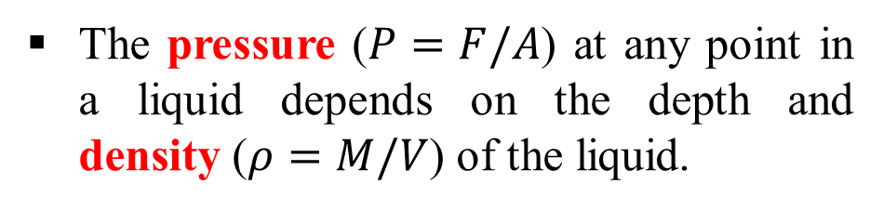
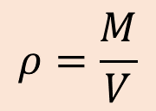
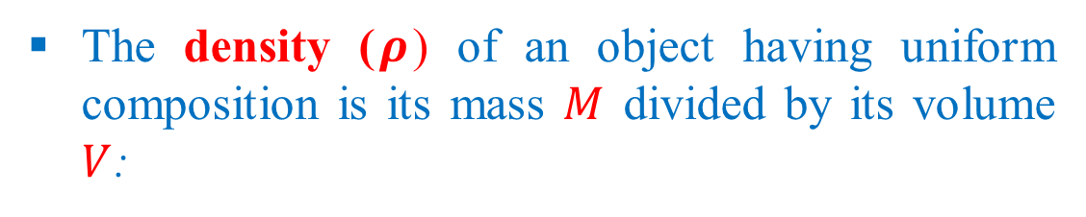
Pressure in Fluid
The three common phases of matter are solid, liquid, and gas.
A solid has a definite shape and size.
A liquid has a fixed volume but can be any shape.
A gas can be any shape and also can be easily compressed.
Liquids and gases both flow, and are called fluids.
The density ($ρ$) of an object having uniform composition is its mass $M$ divided by its volume $V$:
$$ρ=\frac{M}{V}$$
The pressure ($P=F/A$) at any point in a liquid depends on the depth and density ($ρ=M/V$) of the liquid.
Atmospheric pressure is the pressure exerted by the air around us and varies a little according to atmospheric conditions.
Pressure gauges measure pressure relative to atmospheric pressure but absolute pressure is defined as force applied perpendicular to a particular area.
K.Yeneayehu (ASTU)
June, 2022
(ASTU)
Pressure in fluid - 12/34

Slide 13
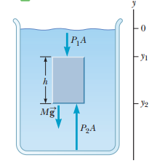




Pressure in Fluid
When a fluid is at rest in a container, all portions of the fluid must be in static equilibrium.
Three external forces are acting on the object to be static equilibrium.
$$P_{2}A−P_{1}A−Mg=0$$
$$M=ρV=ρA(y_{1}−y_{2})$$
Therefore the pressure at the bottom
$$P_{2}=P_{1}+ρg(y_{1}−y_{2})$$
The weight of all the air from sea level to the edge of space results in an atmospheric pressure of $P_{0}=1.013×{10}^{5} Pa$ at sea level.
$$P=P_{0}+ρgh$$
The pressure $P$ at a depth $h$ below the surface of a liquid open to the atmosphere is greater than atmospheric pressure by the amount $ρgh$.
(ASTU)
Pressure in fluid - 13/34
June, 2022

Slide 14
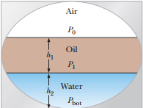


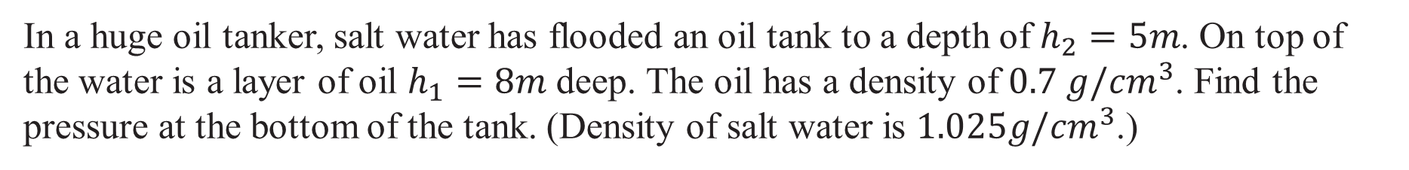
Pressure in Fluid
Example
In a huge oil tanker, salt water has flooded an oil tank to a depth of $h_{2}=5m$. On top of the water is a layer of oil $h_{1}=8m$ deep. The oil has a density of $0.7 g/{cm}^{3}$. Find the pressure at the bottom of the tank. (Density of salt water is $1.025g/{cm}^{3}$.)
(ASTU)
Pressure in fluid - 14/34
June, 2022

Slide 15
Pascal’s Principle
Pascal's law states that pressure at any point is the same in all directions and hence it is a scalar quantity in fluid statics.
Pascal's law states that any two points at same elevation in a continuous mass of static fluid will be at the same pressure.
Pascal's law or the principle of transmission of fluid-pressure is a principle in fluid mechanics that states that pressure exerted anywhere in a confined incompressible fluid is transmitted equally in all directions throughout the fluid such that the pressure variations (initial differences) remain the same.
(ASTU)
Pascal’s Principle - 15/34
June, 2022

Slide 16
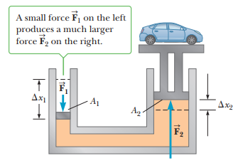

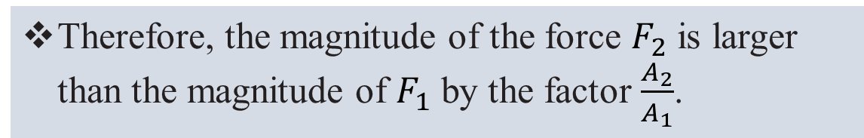
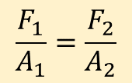
Pascal’s Principle
An important application of Pascal’s principle is the hydraulic press.
A downward force $F_{1}$ is applied to a small piston of area $A_{1}$. The pressure is transmitted through a fluid to a larger piston of area $A_{2}$.
$$P_{1}=P_{2}$$
$$\frac{F_{1}}{A_{1}}=\frac{F_{2}}{A_{2}}$$
Therefore, the magnitude of the force $F_{2}$ is larger than the magnitude of $F_{1}$ by the factor $\frac{A_{2}}{A_{1}}$.
(ASTU)
Pascal’s Principle - 16/34
June, 2022

Slide 17
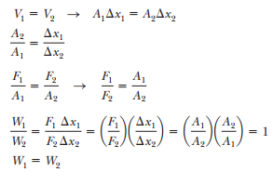
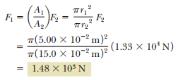

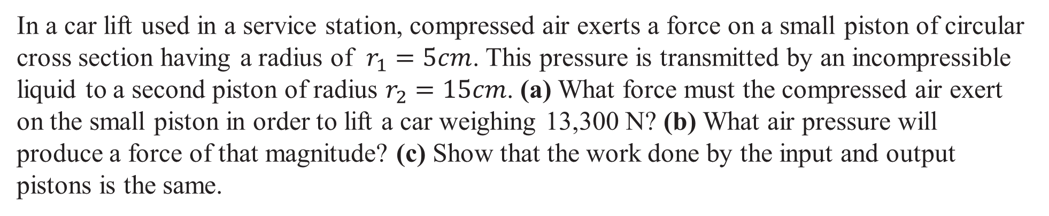
Pascal’s Principle
Example
In a car lift used in a service station, compressed air exerts a force on a small piston of circular cross section having a radius of $r_{1}=5cm$. This pressure is transmitted by an incompressible liquid to a second piston of radius $r_{2}=15cm$. (a) What force must the compressed air exert on the small piston in order to lift a car weighing 13,300 N? (b) What air pressure will produce a force of that magnitude? (c) Show that the work done by the input and output pistons is the same.
(ASTU)
Pascal’s Principle - 17/34
June, 2022

Slide 18
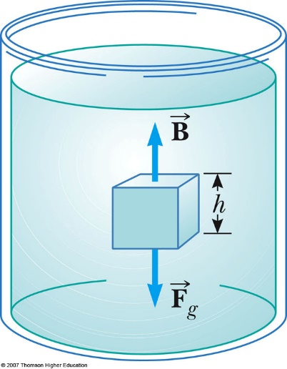
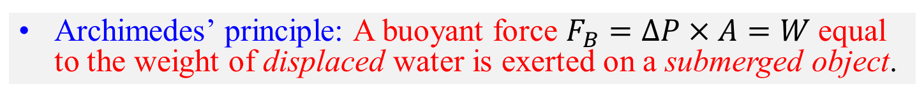


Archimedes’ Principle
Totally submerged
The pressure difference ($∆P=P_{bottom}−P_{top}$) times area ($A$) must equal the weight ($W$) for an object to float.
$$∆P×A=W$$
Archimedes’ principle: A buoyant force $F_{B}=∆P×A=W$equal to the weight of displaced water is exerted on a submerged object.
$$F_{B}=ρghA=ρhV$$
The object will float if the buoyant force is big enough to support the object’s weight.
(ASTU)
Archimedes Principle - 18/34
June, 2022

Slide 19

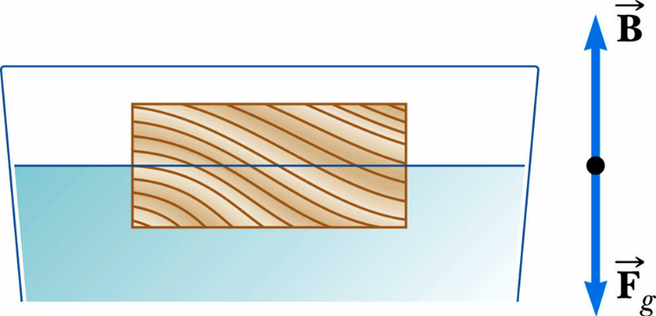
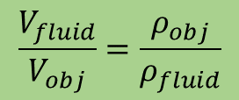

Archimedes’ Principle
Partially submerged
The volume of the fluid displaced by the object, $V_{fluid}$ isn’t the object volume but is the portion of the volume of the object beneath the fluid level.
$$F_{B}−F_{g}=ρ_{fluid}gV_{fluid}−ρ_{obj}gV_{obj}$$
$$\frac{V_{fluid}}{V_{obj}}=\frac{ρ_{obj}}{ρ_{fluid}}$$
Archimedes’ Principle: The volume fraction of a floating object which is submerged is equal to the ratio of the density of the object to the density of the fluid.
(ASTU)
Archimedes Principle - 19/34
June, 2022

Slide 20
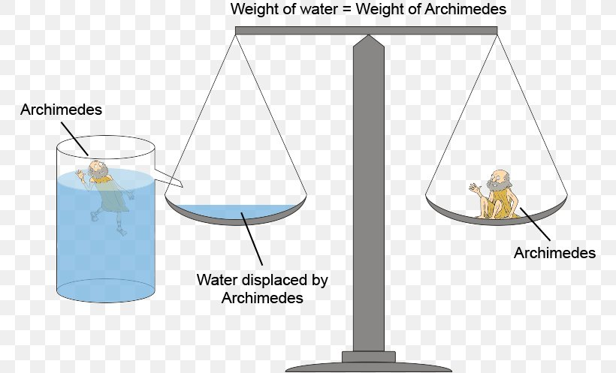
Archimedes’ Principle
The object will displace just enough water so that the buoyant force = its weight.
If it displaces as much water as possible and this does not equal its weight, it will sink.
(ASTU)
Archimedes Principle - 20/34
June, 2022

Slide 21
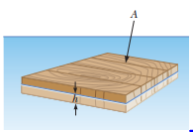


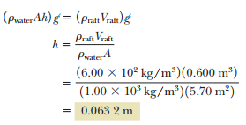
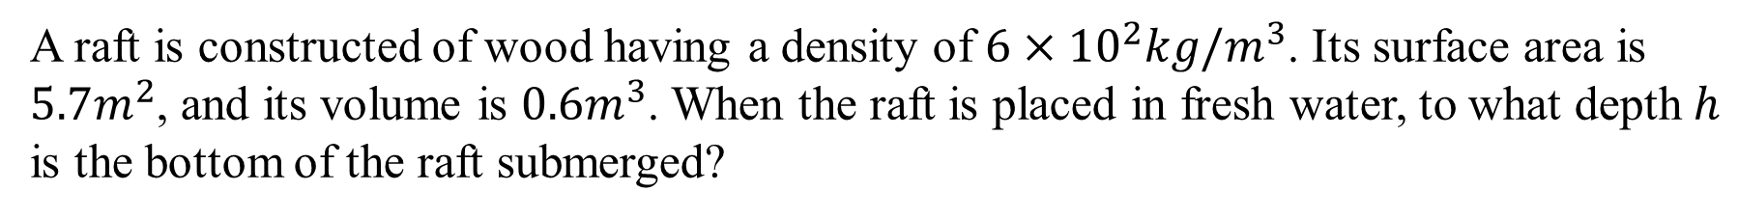
Archimedes’ Principle
Example
A raft is constructed of wood having a density of $6×{10}^{2}kg/m^{3}$. Its surface area is $5.7m^{2}$, and its volume is $0.6m^{3}$. When the raft is placed in fresh water, to what depth $h$ is the bottom of the raft submerged?
(ASTU)
Archimedes Principle - 21/34
June, 2022

Slide 22
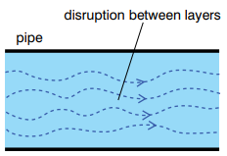
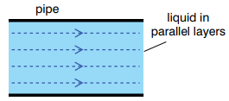
Fluid dynamics
When a fluid is in motion, its flow can be characterized in one of two ways.
If every particle that passes a particular point moves along exactly the same smooth path followed by previous particles passing that point. This path is called a streamline or laminar.
In contrast, the flow of a fluid becomes irregular, or turbulent, above a certain velocity or under any conditions that can cause abrupt changes in velocity.
(ASTU)
Fluid dynamics - 22/34
June, 2022

Slide 23
Fluid dynamics
Many features of fluid motion can be understood by considering the behavior of an ideal fluid, which satisfies the following conditions:
The fluid is no-viscous, which means there is no internal friction force between adjacent layers.
The fluid is incompressible, which means its density is constant.
The fluid motion is steady, meaning that the velocity, density, and pressure at each point in the fluid don’t change with time.
The fluid moves without turbulence.
(ASTU)
Fluid dynamics - 23/34
June, 2022

Slide 24
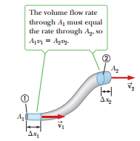




Equation of continuity
Equation of continuity the mass flow rate of fluid flowing into a system is equal to the mass flow rate of fluid leaving the system float.
The equation of continuity in fluid dynamics states that the volume flow rate of an ideal fluid flowing through a closed system is the same at every point.
$$∆x_{1}=v_{1}∆t$$
$$∆x_{2}=v_{2}∆t$$
The mass contained in the bottom and top blue regions
$$∆M_{1}=ρ_{1}A_{1}{∆x}_{1}=ρ_{1}A_{1}v_{1}∆t$$
$$∆M_{2}=ρ_{2}A_{2}{∆x}_{2}=ρ_{2}A_{2}v_{2}∆t$$
(ASTU)
Equation of continuity - 24/34
June, 2022

Slide 25
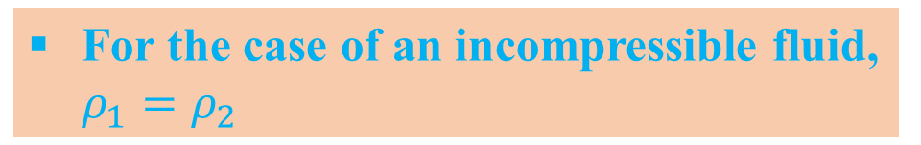
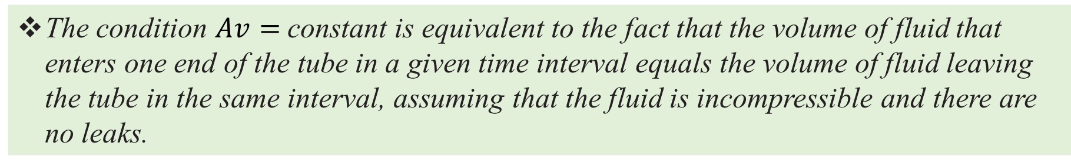
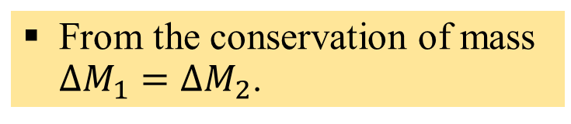


Equation of continuity
From the conservation of mass $∆M_{1}=∆M_{2}$.
For the case of an incompressible fluid, $ρ_{1}=ρ_{2}$
$$ρ_{1}A_{1}v_{1}=ρ_{2}A_{2}v_{2}$$
$$A_{1}v_{1}=A_{2}v_{2}$$
Equation of continuity.
From this result, we see that the product of the cross-sectional area of the pipe and the fluid speed at that cross section is a constant.
The product $Av$, which has dimensions of volume per unit time, is called the flow rate.
The condition $Av=$ constant is equivalent to the fact that the volume of fluid that enters one end of the tube in a given time interval equals the volume of fluid leaving the tube in the same interval, assuming that the fluid is incompressible and there are no leaks.
(ASTU)
Equation of continuity - 25/34
June, 2022

Slide 26

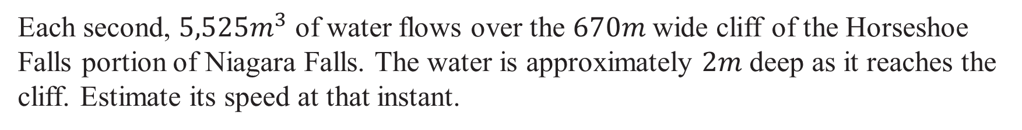
Equation of continuity
Example
Each second, $5,525m^{3}$ of water flows over the $670m$wide cliff of the Horseshoe Falls portion of Niagara Falls. The water is approximately $2m$ deep as it reaches the cliff. Estimate its speed at that instant.
(ASTU)
Equation of continuity - 26/34
June, 2022

Slide 27
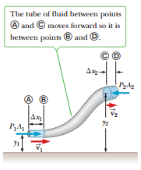
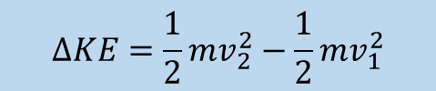
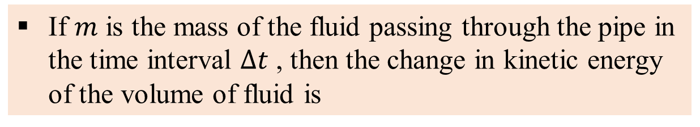



Bernoulli’s equation
The work done on the lower end of the fluid by the fluid behind it is
$$W_{1}=F_{1}{∆x}_{1}=P_{1}A_{1}{∆x}_{1}=P_{1}V$$
In a similar manner, the work done on the fluid on the upper portion
$$W_{2}=−P_{2}A_{2}{∆x}_{2}={−P}_{2}V$$
The net work done by these forces in the time $∆t$ is
$$W_{net}=P_{1}V{−P}_{2}V$$
If $m$ is the mass of the fluid passing through the pipe in the time interval $∆t$ , then the change in kinetic energy of the volume of fluid is
$$∆KE=\frac{1}{2}mv_{2}^{2}−\frac{1}{2}mv_{1}^{2}$$
(ASTU)
Bernoulli’s equation - 27/34
June, 2022

Slide 28


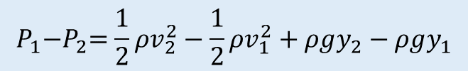
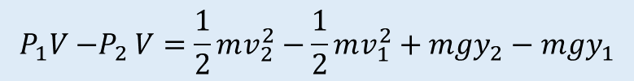
Bernoulli’s equation
The change in the gravitational potential energy is
$$∆PE=mgy_{2}−mgy_{1}$$
Because the net work done by the fluid on the segment of fluid shown in Figure changes the kinetic energy and the potential energy of the non-isolated system, we have
$$W_{net}=∆KE+∆PE$$
The three terms in this equation are those we have just evaluated.
$$P_{1}V{−P}_{2}V=\frac{1}{2}mv_{2}^{2}−\frac{1}{2}mv_{1}^{2}+mgy_{2}−mgy_{1}$$
If we divide each term by $V$ and recall that $ρ=m/V$, this expression becomes
$$P_{1}{−P}_{2}=\frac{1}{2}ρv_{2}^{2}−\frac{1}{2}ρv_{1}^{2}+ρgy_{2}−ρgy_{1}$$
(ASTU)
Bernoulli’s equation - 28/34
June, 2022

Slide 29
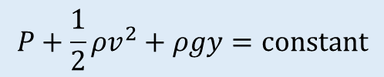
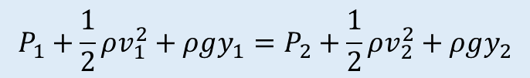
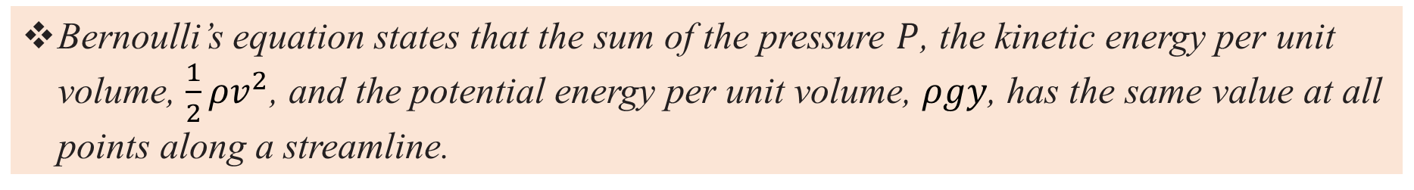
Bernoulli’s equation
Rearrange the terms as follows:
$$P_{1}+\frac{1}{2}ρv_{1}^{2}+ρgy_{1}=P_{2}+\frac{1}{2}ρv_{2}^{2}+ρgy_{2}$$
The above equation is Bernoulli's equation, often express as
$$P+\frac{1}{2}ρv^{2}+ρgy=constant$$
Bernoulli’s equation states that the sum of the pressure $P$, the kinetic energy per unit volume, $\frac{1}{2}ρv^{2}$, and the potential energy per unit volume, $ρgy$, has the same value at all points along a streamline.
This result is often expressed by the statement that swiftly moving fluids exert less pressure than do slowly moving fluids.
(ASTU)
Bernoulli’s equation - 29/34
June, 2022

Slide 30
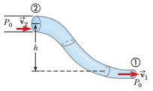

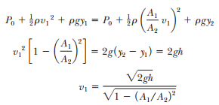


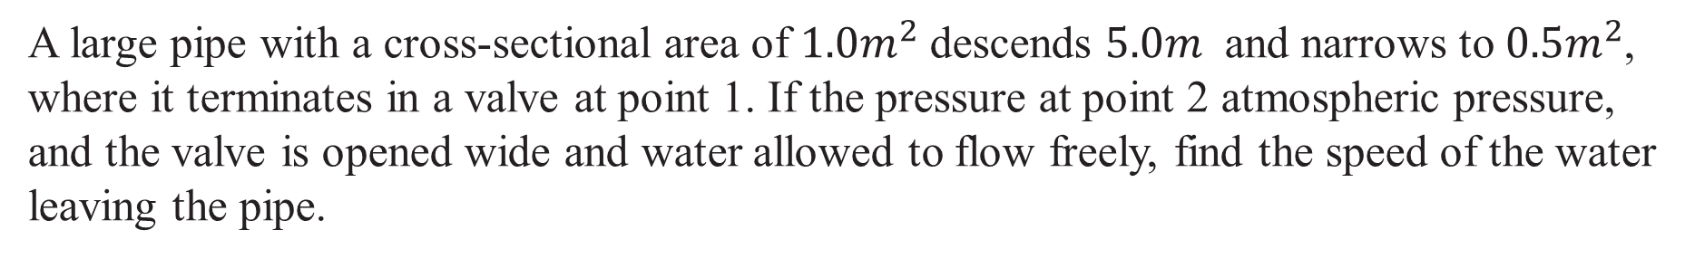
Bernoulli’s equation
Example
A large pipe with a cross-sectional area of $1{.0m}^{2}$ descends $5.0m$ and narrows to $0{.5m}^{2}$, where it terminates in a valve at point 1. If the pressure at point 2 atmospheric pressure, and the valve is opened wide and water allowed to flow freely, find the speed of the water leaving the pipe.
(ASTU)
Bernoulli’s equation - 30/34
June, 2022

Slide 31
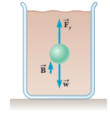




Stokes’s law and terminal velocity
When an object (sphere with radius $r$) falls through a viscous medium, three forces act on it, as shown in Figure: $F_{r}$, the force of friction; $F_{B},$the buoyant force of the fluid; and $W$, the force of gravity acting on the sphere.
The magnitude of the resistive force on the object of radius r falling slowly through a fluid of viscosity $η$ with speed $v$ is given by
$$F_{r}=6πηrv$$
Stokes’s law
The magnitude of weight of the object $W$ is given by
$$W=ρgV=ρg\left(\frac{4}{3}πr^{3}\right)$$
(ASTU)
Stokes’s law and terminal velocity - 31/34
June, 2022

Slide 32





Stokes’s law and terminal velocity
According to Archimedes' principle, the magnitude of the buoyant force is equal to the weight of the fluid displaced by the sphere,
$$F_{B}=ρ_{f}gV=ρ_{f }g\left(\frac{4}{3}πr^{3}\right)$$
At the instant the sphere begins to fall, the force of friction is zero because the speed of the sphere is zero. As the sphere accelerates, its speed increases and so does $F_{r}$. Finally, at a speed called the terminal speed $v$, the net force goes to zero.
$$F_{B}+F_{r}=W$$
$$6πηrv+ρ_{f }g\left(\frac{4}{3}πr^{3}\right)=ρg\left(\frac{4}{3}πr^{3}\right)$$
$$v=\frac{2gr^{2}}{9η}\left(ρ−ρ_{f}\right)$$
(ASTU)
Stokes’s law and terminal velocity - 22/34
June, 2022

Slide 33




Stokes’s law and terminal velocity
Example
Small spheres of diameter $1.0mm$ fall through 20°C water with a terminal speed of $1.1cm/s$. Calculate the density of the spheres.
$η_{water}$at ${20}_{C}^{0}=1×{10}^{−3} N.s/m^{2}$
$$ρ=\frac{9ηv}{2gr^{2}}+ρ_{f}$$
$$ρ=\frac{9×{10}^{−3}×1.1×{10}^{−2}}{2×9.8×5×{10}^{−4}}+1000$$
$$=0.01+1000=1000.01kg/m^{3}$$
(ASTU)
Stokes’s law and terminal velocity - 33/34
June, 2022

Slide 34
End
The End, thank you
(ASTU)
End - 34/34
June, 2022

